Slide 1



TAILTAILS
Course: PRJ 666 - Winter 2025
Professor: Abedin Akkok
Group: 02
Group members: Aryan Tuwar, Vivian Zhonghui Liu, Haroon Ahmed Bajwa, Mrinaal Nagpal, Mustafa Al-Obaidi
Report date: Feb 11, 2025

Slide 2


PROJECT INFORMATION
Start date: 23/01/2025
End date: 16/04/2025
Phase: Implementation phase
The TailTales Website aims to provide a platform for pet owners to book grooming appointments, discover trendy pet products, and read pet-related blogs.
Currently, our team is focused on integrating core functionalities.

Slide 3
PERFORMANCE DURING LAST PERIOD
Achievement
Incomplete
Our team built a responsive navbar using Framer Motion, providing smooth website navigation with links to essential sections.
All necessary technical documents for the current project stage were completed.
System operation
Database setup
API details
Front-end and back-end connection methods
A testing plan
Project's online deployment plan
Key website components:
Hero Section
Trending Products Section
Appointment Booking
Blog Section
Signup Section
Footer (Have only been started)
These components are currently in basic framework form and require significant additional work to be fully functional.

Slide 4
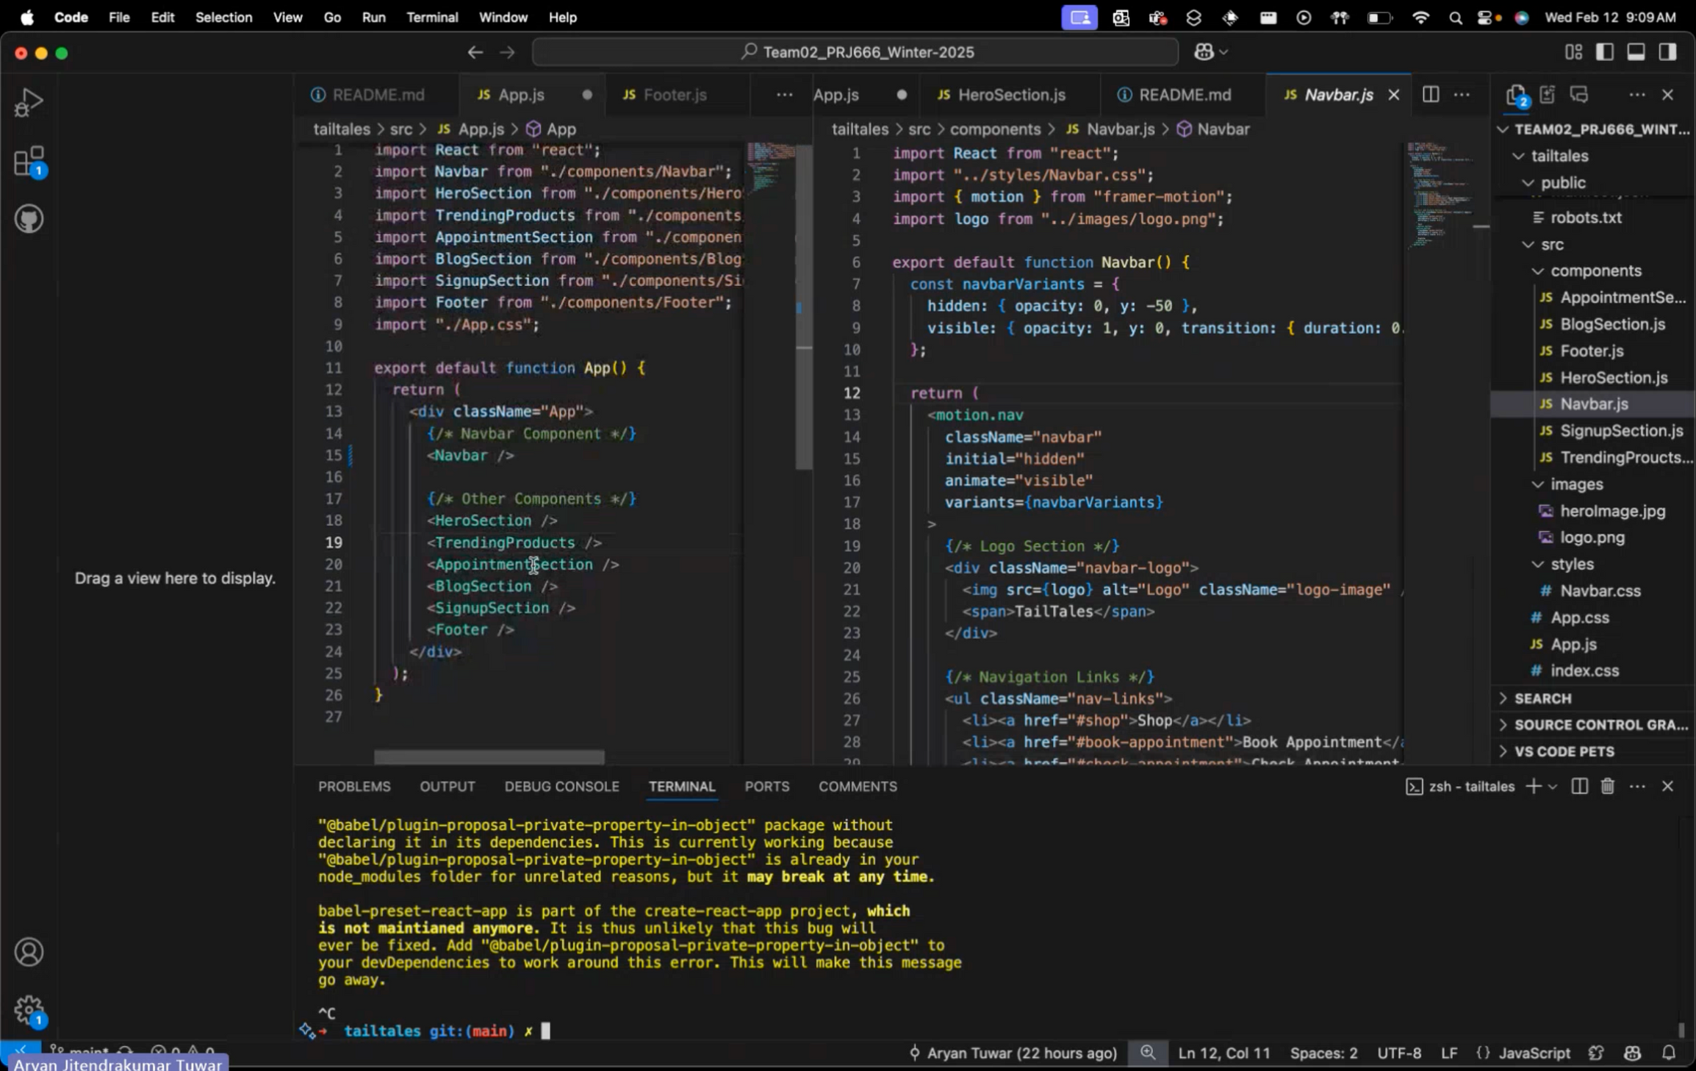

Slide 5
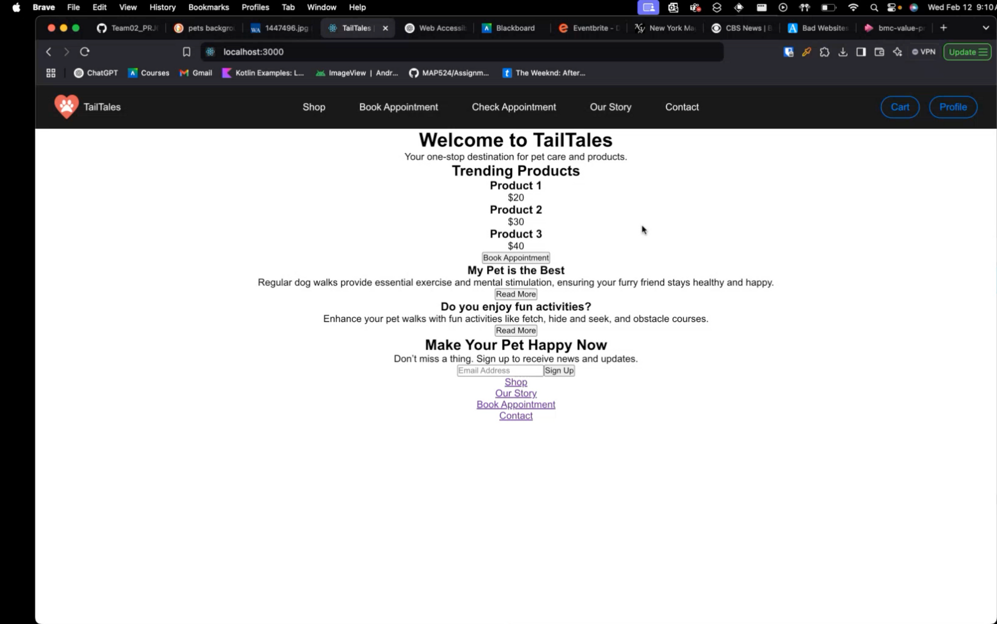

Slide 6
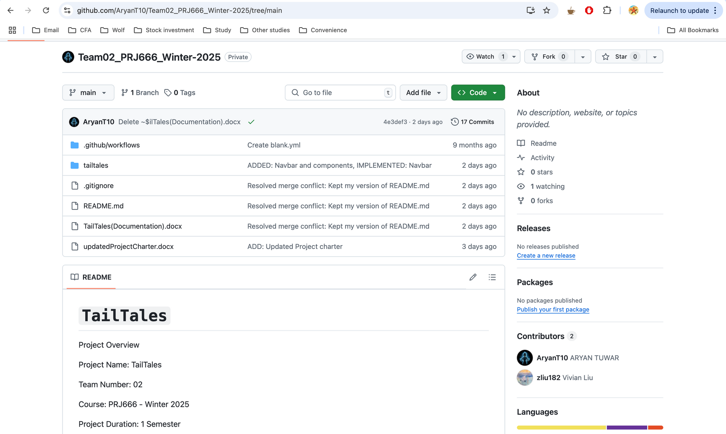
Link: https://github.com/AryanT10/Team02_PRJ666_Winter-2025/tree/main

Slide 7
MILESTONES
Milestone | Planned Date | Actual Date | Status
Navbar & Global Navigation implementation | 15/01/2025 | Before 23/01/2025 | Achieved
Hero Section implementation | 15/01/2025 | Not completed | In Progress
Trending Products Section implementation | 15/01/2025 | Not completed | In Progress
Appointment Booking implementation | 15/01/2025 | Not completed | In Progress
Blog Section implementation | 15/01/2025 | Not completed | In Progress
Signup Section implementation | 15/01/2025 | Not completed | In Progress
Footer implementation | 15/01/2025 | Not completed | In Progress
Cart & Checkout System implementation | 15/01/2025 | Not completed | In Progress
Profile & Authentication System implementation | 15/01/2025 | Not completed | In Progress
Backend API Development | 15/01/2025 | Not completed | In Progress
Appointment Booking Functionality implementation | 15/01/2025 | Not completed | In Progress
Completion of all required technical documentation | 15/01/2025 | Before 23/01/2025 | Achieved

Slide 8
HIGH PRIORITY
ISSUES LOG
Issue | Date Reported | Impact | Status | Resolution Plan
Component Implementation Delays | 11/02/2025 | Risk of overall project delay | Open | Allocate sufficient resources and set clear timelines for completing components. Regularly review progress and adjust resource allocation as needed.
Integration Challenges | 11/02/2025 | Difficulty in integrating frontend and backend components, especially for Cart & Checkout System, Profile & Authentication System, and Appointment Booking Functionality | Open | Foster close communication between frontend and backend developers. Conduct regular cross-team meetings to discuss integration points and address issues promptly.
Testing and Quality Assurance | 11/02/2025 | Potential for undetected bugs in new features | Open | Follow the defined testing plan. Conduct thorough unit and API testing during development. Set up a staging environment for pre-production testing.

Slide 9

PLANNED WORK FOR THE NEXT PERIOD
Cart & Checkout System
Complete implementation for adding products to cart.
Let users manage purchases and finalize checkout (no payment gateway yet).
Profile & Authentication System
Finish User Login/Signup system implementation.
Add user dashboard for managing appointments, orders, and preferences.
Backend API Development
Finalize Node.js & Express backend for user authentication and data handling.
Integrate MongoDB to store appointment, product, and user data.
Appointment Booking Functionality
Let users select available time slots and confirm appointments.
Use SendGrid - like service for email confirmations and reminders.
Component Completion
Finish implementing Hero, Trending Products, Appointment Booking, Blog, Signup, and Footer components.

Slide 10


THANK YOU

